Slide 1
Open the Black Box
Explanation of the Use of Naive Bayes Model for NLP to Classify Reddit Posts
Kai Zhao

Slide 2
Agenda
Part 1: Reddit Post Classification Using NLP
State the Problem
Data
Methodology
Results
Conclusion & Recommendation
Next Step
Part 2: A Closer Look at Multinomial Naive Bayes Model
Reproduce MNB Model Results from Part 1
Bonus: Scattertext Visualization

Slide 3
STATE THE PROBLEM
DATA
METHODOLOGY
RESULTS
NAIVE BAYES
BONUS
PART I:
Reddit Post Classification Using NLP

Slide 4

STATE THE PROBLEM
DATA
METHODOLOGY
RESULTS
NAIVE BAYES
BONUS
State the Problem
Reddit
Posts

Slide 5
STATE THE PROBLEM
DATA
METHODOLOGY
RESULTS
NAIVE BAYES
BONUS
r/airquality
904 Posts
Total 1887 Posts
r/breastcancer
983 Posts

Slide 6
STATE THE PROBLEM
DATA
METHODOLOGY
RESULTS
NAIVE BAYES
BONUS
Methodology
EDA & Data Cleaning
Tokenization, Lemmatization, and Vectorization
Train/Test Split
Fit and Run Model Using Pipeline and GridSearchCV
Primary Model: Multinomial Naive Bayes
Alternative Model: Logistic Regression (for comparison)

Slide 7
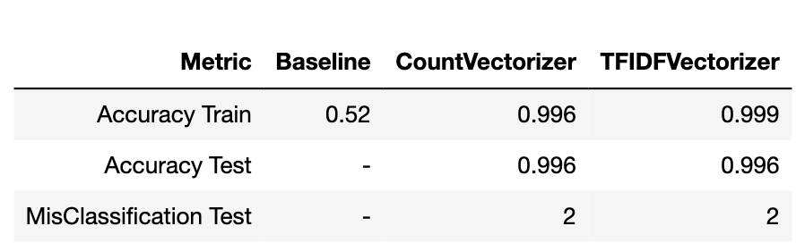
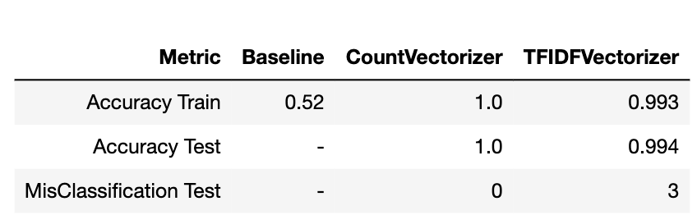
STATE THE PROBLEM
DATA
METHODOLOGY
RESULTS
NAIVE BAYES
BONUS
Results Summary - Accuracy
Naive Bayes
Logistic Regression
Best Model

Slide 8
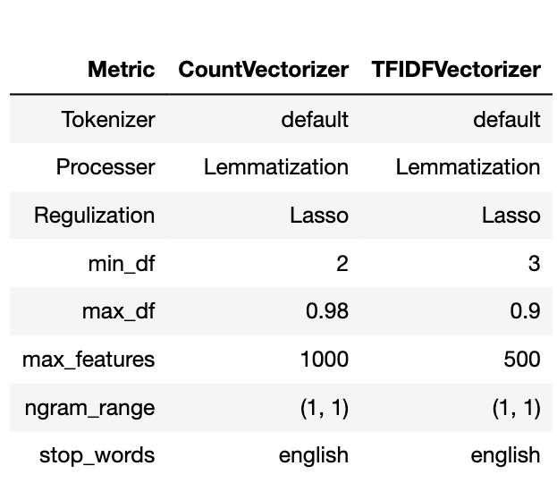
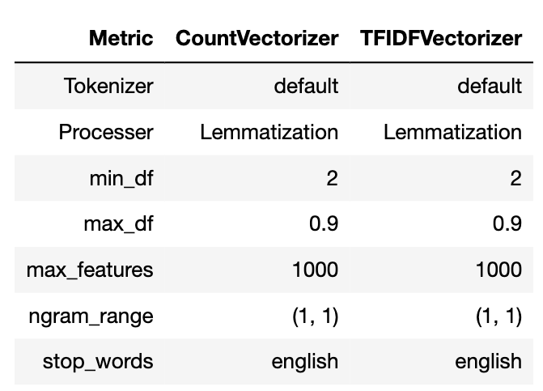
STATE THE PROBLEM
DATA
METHODOLOGY
RESULTS
NAIVE BAYES
BONUS
Results Summary - Parameter
Naive Bayes
Logistic Regression

Slide 9
STATE THE PROBLEM
DATA
METHODOLOGY
RESULTS
NAIVE BAYES
BONUS
Conclusion & Recommendation
Conclusion:
For the selected two subreddits, the Logistic Regression model with Lasso regularization (i.e., 100% accuracy) performs marginally better than the Multinomial Naive Bayes model (i.e., 99.9% accuracy)
The misclassified documents would be correctly classified if reviewed by human.
The concern of the naive assumption (i.e., all features are independent) has little impact to the model’s classification capability for this project.
Recommendation:
Naive Bayes model is generally a good model for text classification and should be considered as a standard choice along with other classification models.
Frequency of the feature matters. Setting a reasonable range of max feature options (e.g, 100, 500, 1000, 2000.. etc.) for GridSearchCV is recommended for best model results.

Slide 10
STATE THE PROBLEM
DATA
METHODOLOGY
RESULTS
NAIVE BAYES
BONUS
Next Step
Further evaluate the model performance by pepeating model multiple times using more similar subreddit posts.
Investigate the impact of number of features and MNB model’s smoothing mechanism.
Find a case when MNB fails to understand the limitation of the model.

Slide 11
STATE THE PROBLEM
DATA
METHODOLOGY
RESULTS
NAIVE BAYES
BONUS
PART II
A Closer Look at Naive Bayes Model

Slide 12
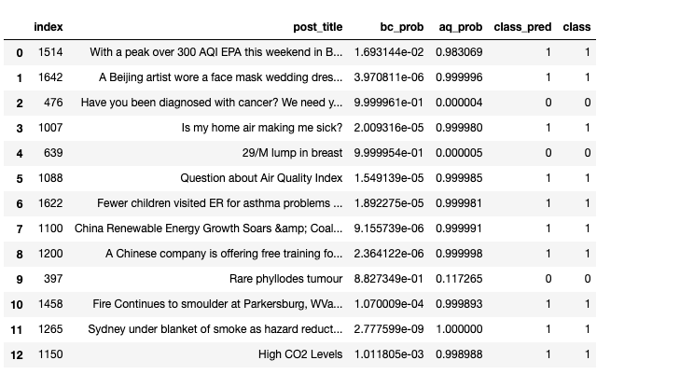
STATE THE PROBLEM
DATA
METHODOLOGY
RESULTS
NAIVE BAYES
BONUS
Reproduce the Results from Part I
Results based on model using X_test data
Notes:
Open the black box by replicate the exact number by hand

Slide 13
STATE THE PROBLEM
DATA
METHODOLOGY
RESULTS
NAIVE BAYES
BONUS
Review of Bayes’ Theorem
Bayes' Theorem (Bayes’ law or Bayes’ rule):
The probability of an event, based on prior knowledge of conditions that might be related to the event
U
U
P(A B)=P(B|A) * P (A)
P(A|B) * P (B)=P(A B)
P(A|B) * P (B)=P(B|A)* P(A)
P(B|A)
P(A)
P(A|B) =
P(B)

Slide 14

STATE THE PROBLEM
DATA
METHODOLOGY
RESULTS
NAIVE BAYES
BONUS
Equation Translation
P(high co2 levels|BC)
P(BC)
P(BC|high co2 levels) =
P(high co2 levels)
Test Data
Train Data
P(high co2 levels|AQ)
P(AQ)
P(AQ|high co2 levels) =
P(high co2 levels)

Slide 15
STATE THE PROBLEM
DATA
METHODOLOGY
RESULTS
NAIVE BAYES
BONUS
Equation Translation
P(high co2 levels|BC)*P(BC)
= P(‘high’|BC) * P(‘co2’|BC) * P(‘levels’|BC) * P(BC)
Naive!!!
BAM!
P(high co2 levels|AQ)*P(AQ)
= P(‘high’|AQ) * P(‘co2’|AQ) * P(‘levels’|AQ) * P(AQ)

Slide 16
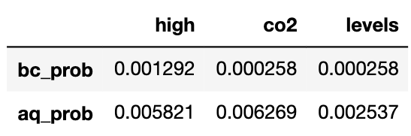
STATE THE PROBLEM
DATA
METHODOLOGY
RESULTS
NAIVE BAYES
BONUS
Simply Plug In Numbers
P(‘high’|BC) * P(‘co2’|BC) * P(‘levels’|BC) * P(BC)
X_train
P(‘high’|AQ) * P(‘co2’|AQ) * P(‘levels’|AQ) * P(AQ)

Slide 17
STATE THE PROBLEM
DATA
METHODOLOGY
RESULTS
NAIVE BAYES
BONUS
Simply Plug In Numbers
P(‘high’|BC) * P(‘co2’|BC) * P(‘levels’|BC) * P(BC)
X_train
P(‘high’|AQ) * P(‘co2’|AQ) * P(‘levels’|AQ) * P(AQ)

Slide 18
STATE THE PROBLEM
DATA
METHODOLOGY
RESULTS
NAIVE BAYES
BONUS
Simply Plug In Numbers
P(‘high’|BC) * P(‘co2’|BC) * P(‘levels’|BC) * P(BC)
X_train
P(‘high’|AQ) * P(‘co2’|AQ) * P(‘levels’|AQ) * P(AQ)

Slide 19
STATE THE PROBLEM
DATA
METHODOLOGY
RESULTS
NAIVE BAYES
BONUS
Simply Plug In Numbers
P(‘high’|BC) * P(‘co2’|BC) * P(‘levels’|BC) * P(BC)
X_train
P(‘high’|AQ) * P(‘co2’|AQ) * P(‘levels’|AQ) * P(AQ)

Slide 20
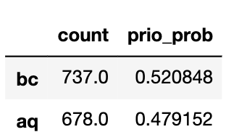
STATE THE PROBLEM
DATA
METHODOLOGY
RESULTS
NAIVE BAYES
BONUS
Simply Plug In Numbers
P(‘high’|BC) * P(‘co2’|BC) * P(‘levels’|BC) * P(BC)
X_train
X_train
P(‘high’|AQ) * P(‘co2’|AQ) * P(‘levels’|AQ) * P(AQ)

Slide 21
STATE THE PROBLEM
DATA
METHODOLOGY
RESULTS
NAIVE BAYES
BONUS
Simply Plug In Numbers
P(‘high’|BC) * P(‘co2’|BC) * P(‘levels’|BC) * P(BC)
= 4.493121 x 10^-11
X_train
X_train
P(‘high’|AQ) * P(‘co2’|AQ) * P(‘levels’|AQ) * P(AQ)
= 4.435206 x 10^-8

Slide 22
STATE THE PROBLEM
DATA
METHODOLOGY
RESULTS
NAIVE BAYES
BONUS
Revisit Equation
P(high co2 levels|BC)
P(BC)
P(BC|high co2 levels) =
P(high co2 levels)
Test Data
Train Data
P(high co2 levels|AQ)
P(AQ)
P(AQ|high co2 levels) =
P(high co2 levels)

Slide 23
STATE THE PROBLEM
DATA
METHODOLOGY
RESULTS
NAIVE BAYES
BONUS
Revisit Equation
P(BC|high co2 levels) =
4.493121 x 10^-11
P(high co2 levels)
Test Data
Train Data
P(AQ|high co2 levels) =
4.435206 x 10^-8
P(high co2 levels)

Slide 24
STATE THE PROBLEM
DATA
METHODOLOGY
RESULTS
NAIVE BAYES
BONUS
Simply Plug In Numbers
P(‘high’|BC) * P(‘co2’|BC) * P(‘levels’|BC) * P(BC)
= 4.493121 x 10^-11
P(‘high’|AQ) * P(‘co2’|AQ) * P(‘levels’|AQ) * P(AQ)
= 4.435206 x 10^-8

Slide 25
STATE THE PROBLEM
DATA
METHODOLOGY
RESULTS
NAIVE BAYES
BONUS
Simply Plug In Numbers
P(‘high’|BC) * P(‘co2’|BC) * P(‘levels’|BC) * P(BC)
= 4.493121 x 10^-11
P(‘high co2 levels’|BC) * P(BC)
P(‘high co2 levels’|AQ) * P(AQ)
P(‘high’|AQ) * P(‘co2’|AQ) * P(‘levels’|AQ) * P(AQ)
= 4.435206 x 10^-8

Slide 26
STATE THE PROBLEM
DATA
METHODOLOGY
RESULTS
NAIVE BAYES
BONUS
Simply Plug In Numbers
P(‘high’|BC) * P(‘co2’|BC) * P(‘levels’|BC) * P(BC)
= 4.493121 x 10^-11
P(‘high co2 levels’|BC) * P(BC)
P(‘high co2 levels’ BC)
U
DOUBLE
BAM!!
P(‘high co2 levels’)
= 4.439699 x 10^-8
P(‘high co2 levels’ AQ)
U
P(‘high co2 levels’|AQ) * P(AQ)
P(‘high’|AQ) * P(‘co2’|AQ) * P(‘levels’|AQ) * P(AQ)
= 4.435206 x 10^-8

Slide 27
STATE THE PROBLEM
DATA
METHODOLOGY
RESULTS
NAIVE BAYES
BONUS
Revisit Equation
P(BC|high co2 levels) =
4.493121 x 10^-11
P(high co2 levels)
4.439699 x 10^-8
Test Data
Train Data
P(AQ|high co2 levels) =
4.435206 x 10^-8
P(high co2 levels)
4.439699 x 10^-8

Slide 28
STATE THE PROBLEM
DATA
METHODOLOGY
RESULTS
NAIVE BAYES
BONUS
Final Verification
P(BC|high co2 levels) =
4.493121 x 10^-11
= 1.011805 x 10^-3
4.439699 x 10^-8
TRIPLE
BAM!!!
P(AQ|high co2 levels) =
4.435206 x 10^-8
= 0.998988
4.439699 x 10^-8

Slide 29
STATE THE PROBLEM
DATA
METHODOLOGY
RESULTS
NAIVE BAYES
BONUS
BONUS?

Slide 30
STATE THE PROBLEM
DATA
METHODOLOGY
RESULTS
NAIVE BAYES
BONUS
Visualization Using Scattertext

Slide 31
STATE THE PROBLEM
DATA
METHODOLOGY
RESULTS
NAIVE BAYES
BONUS
Quick Review of Two Concepts
1. Harmonic Mean
arithmetic mean of a and b = (a + b)/2
geometric mean of a and b = sqrt(a*b)
harmonic mean of a and b = 2/(1/a + 1/b) = 2ab/(a+b)
“the reciprocal of the arithmetic mean of the reciprocals of the given set of observations”

Slide 32
STATE THE PROBLEM
DATA
METHODOLOGY
RESULTS
NAIVE BAYES
BONUS
Quick Review of Two Concepts
2. F-Score: the metric measures the usefulness
 | Predict Breast Cancer | Predict Not Breast Cancer
Actual Breast Cancer | 10 | 8
Actual Not Breast Cancer | 2 | 99,980
Accuracy = (10 + 99,980) / 100,000 = 99.99% - amazingly accurate but useless
Precision = TP/(TP + FP) = 10/(10+2) = 83.3%
Recall = TP/(TP+FN) = 10/(10 + 8) = 55.6%
F-Score = 2*Precision*Recall/(Precision + Recall) = 2TP / (2TP + FN + FP) Range from 0 to 1
F-Score = 20/(20+8+2) = 66.7% much more representative. Especially for unbalanced data.

Slide 33
STATE THE PROBLEM
DATA
METHODOLOGY
RESULTS
NAIVE BAYES
BONUS
Visualization with Scattertext
Juypter Notbook Presentation
(link here)

